Slide 1



Influenza Season Data Analysis
Zahid Niloy

Slide 2

Context: Tackling Influenza's Impact on the Elderly
Influenza, commonly known as the flu, poses a significant public health challenge, particularly for the elderly. Each year, it leads to substantial mortality and hospitalization rates, with those aged 65 and older bearing a disproportionate burden, accounting for 70-85% of flu-related deaths annually. Understanding the dynamics of influenza and identifying effective intervention strategies are crucial for mitigating its impact on this vulnerable population..

Slide 3



Data analysis plays a pivotal role in deciphering the complexities of influenza, helping us to uncover patterns, predict outbreaks, and evaluate the effectiveness of public health interventions. By leveraging data-driven insights, I could develop more targeted and impactful strategies to protect our aging population.

Slide 4

Key Questions Guiding The Analysis:
What factors contribute to the higher influenza-related mortality and hospitalization rates among the 65+ age group? Is it primarily due to weakened immune systems, the prevalence of chronic conditions, or other socio-economic factors?
How can we harness the power of data analysis to identify the most effective prevention and treatment strategies? Can we optimize vaccination campaigns, improve early detection methods, or enhance treatment protocols to reduce the severity of influenza?

Slide 5


Skills and Tools Applied
Descriptive Statistics:
Statistical and Visual Analysis: Unveiling the Story Behind the Numbers
Calculating key metrics such as mean, median, and standard deviation to summarize the characteristics of the data.
Trend Analysis
Examining how mortality and hospitalization rates have changed over time to identify patterns and predict future trends
Having established the critical need to address influenza's impact on the elderly.
Tableau visualization
Creating interactive charts, graphs, and dashboards to visually represent the data and facilitate the identification of key insights..
Advanced Excel
Utilizing Excel functions to refine data and perform calculations

Slide 6
What are the Primary drivers?
Any trends in hospitalization amongs the elderly?
The project focused on performing statistical and visual analysis to identify the factors driving higher mortality and hospitalization rates among the 65+ age group
Key Questions Explored
What are the vaccine outcomes in the 65+ age group?

Slide 7

Hospitalization Rate
Mortality Rate Trend
Peaked during flu season
Increasing
65+ age group shows an increasing trend from 2012 to 2017 before stabilizing in recent years
This indicated a continued burden on the healthcare system

Slide 8
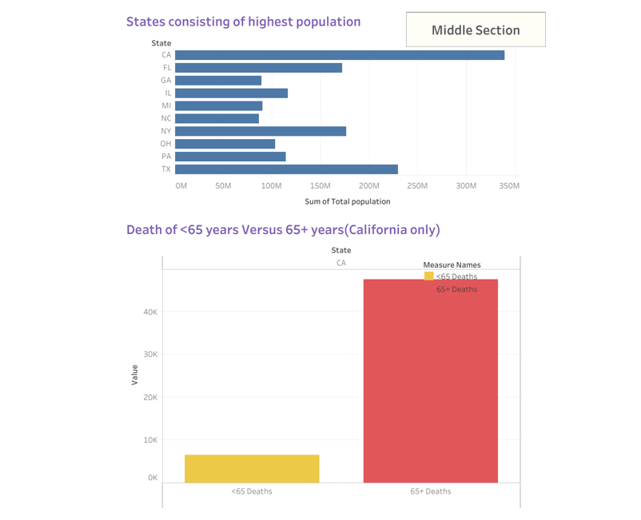
Analysis
The charts showcases:
the need for staff to administer high level of vaccination
the geographical distribution of staffing locations within the organization

Slide 9
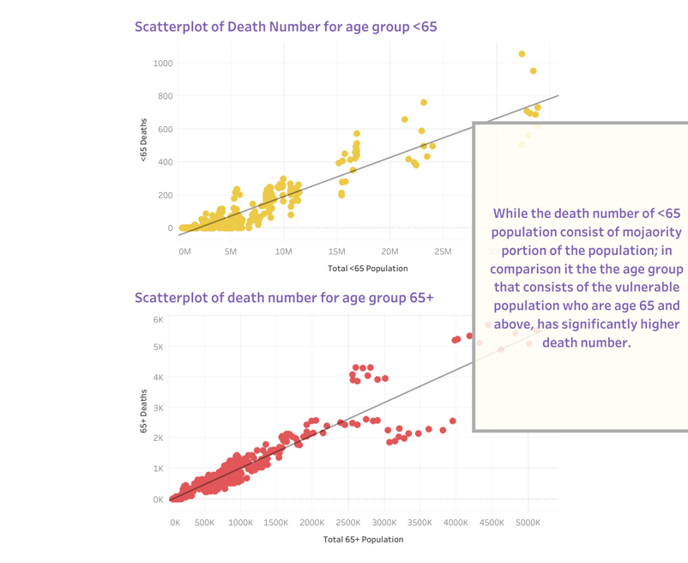
Analysis
The Graphs indicate:
The change/impact on staff
Showing the death distribution among different states

Slide 10
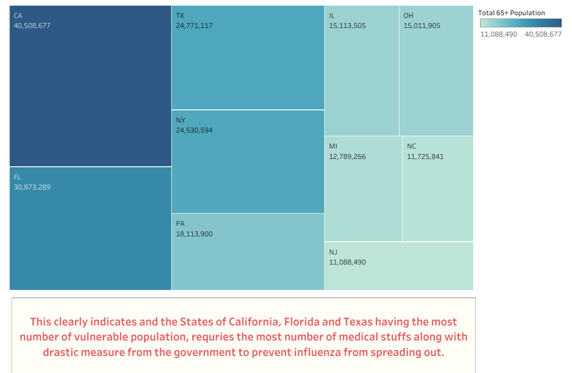
Analysis
Tree diagram indicates:
Visits from Vulnerable Populations": Displaying the density of visits
Vulnerable population by state": Displaying the distribution of population

Slide 11



Towards a Healthier Future for Our Seniors
This project set out to analyze influenza data and identify strategies for mitigating its impact on the elderly, who are disproportionately affected by this seasonal illness.
Through rigorous statistical and visual analysis, I have uncovered key insights that can inform targeted interventions and improve public health outcomes

Slide 12


Key Findings
The 65+ age group is particularly vulnerable, experiencing significantly higher mortality and hospitalization rates compared to other age groups
Seasonal patterns in hospitalization rates indicate a need for proactive measures during peak flu seasons
Vaccination plays a crucial role in reducing the severity of influenza's impact on the elderly, although correlation doesn't equal causation
Lack of vaccination and co-occurring conditions are key factors that may contribute to higher mortality rates

Slide 13

Based on these findings, the following actions are recommended:
Proactive Vaccination: Prioritize 65+ vaccination for maximum protection.
Timely Treatment: Enhance early detection and rapid antiviral access.
Informed Public: Boost awareness on senior-specific risks and prevention

Slide 14
Limitations
The analysis was limited by the availability of aggregate data, which lacked individual-level patient information. Additionally, underreporting and inconsistencies in testing protocols may have affected the accuracy of our results.

Slide 15
Further Research Should Focus On
Acquiring more granular data to enable a deeper understanding of individual risk factors
Conducting long-term trend analysis to identify emerging patterns and predict future outbreaks
Evaluating the cost-effectiveness of different intervention strategies to optimize resource allocation

Slide 16
To monitor the impact of these recommendations, the following metrics are proposed:
Hospitalization rates per 100,000 for the 65+ age group, measuring the effectiveness of preventive measures
Years of Life Lost (YLL) due to influenza mortality, assessing the overall impact of influenza on the elderly population.

